Slide 1


University Second Hand Book Sales and Exchange Platform
Intermediate Presentation
Instructor: Duygu Celik
Group NO: 11
Team Leader:
Maaz Qureshi 21904531
Team Members:
Saad Ahmed 22701636 Syed Fazal 23700460
Samer Qadduomi 20910791
CMSE322 2024-2025

Slide 2
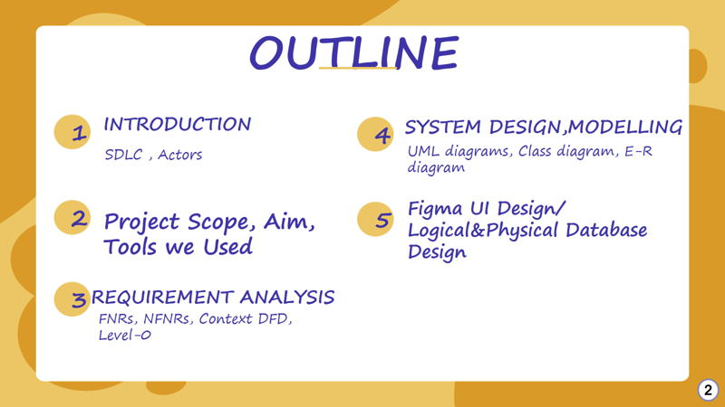

Slide 3
Introduction
UniBookExchange – a mobile app for buying, selling, and swapping second-hand textbooks.
University students and any individuals seeking affordable educational materials.
High cost of new textbooks strains student budgets.
No centralized, easy way to exchange or sell used books.
Sustainability goal: reduce waste by reusing books.
React Native app

Slide 4
Software Development Life Cycle (SDLC)
Increment model :
Get a simple, working app into students’ hands right away—no waiting months for “everything” to be done
Break the project into bite-sized chunks so each new feature is easier to build, test, and polish
After each slice goes live, hear directly from real users (“Hey, can the chat be faster?”) and immediately make it better
Stay flexible: shuffle or add features (smarter search, free-PDF delivery) without blowing up what’s already working
Keep quality high by testing and refining each piece on its own, so the whole system stays solid as it grows

Slide 5
Aim of the project
Cross-platform mobile app (iOS/Android) for peer-to-peer textbook sales & exchange
Reduce student textbook costs
Promote sustainability via book reuse
Ensure secure, maintainable, scalable architecture

Slide 6
Key features:
Listings (create/edit/delete)
Advanced search & filters (price, location, course)
Location-based discovery
In-app chat & notifications
Admin moderation dashboard

Slide 7
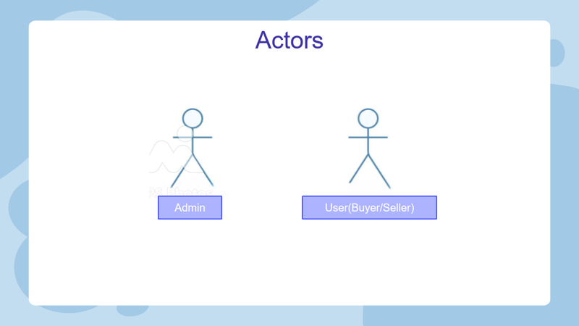

Slide 8
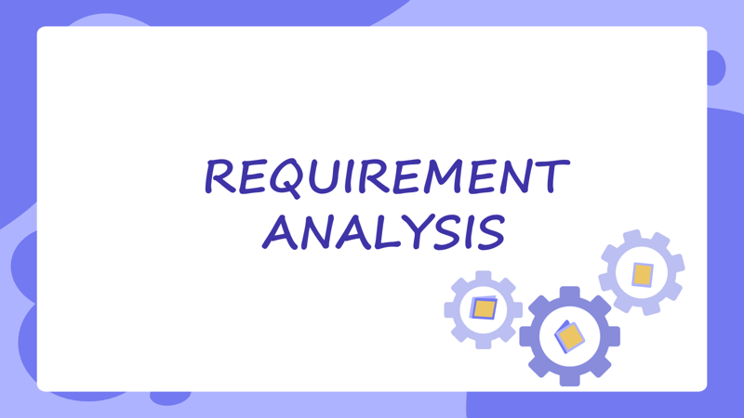

Slide 9


FUNCTIONAL REQUIREMENTS
Book Exchange System
Book Listing and Search
In – App Messaging
Location Based Search
Admin Panel

Slide 10





NON - FUNCTIONAL REQUIREMENTS

Slide 11
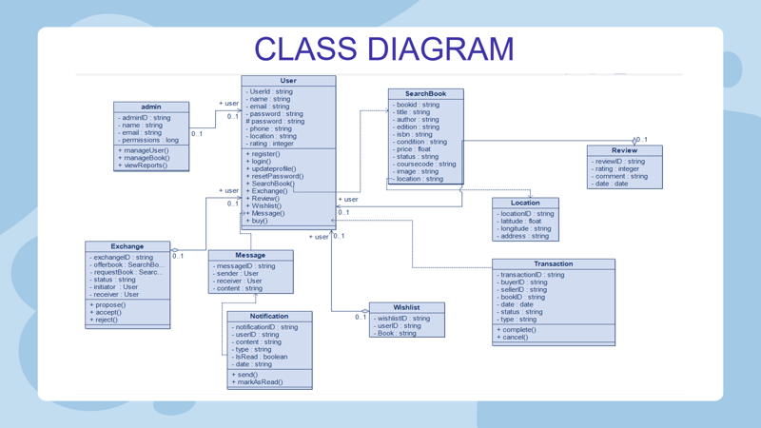

Slide 12
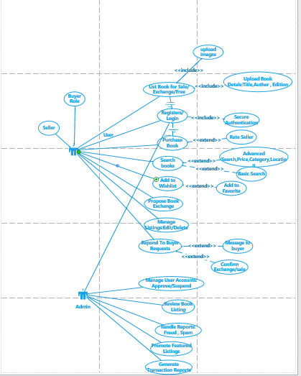
Use Case diagrams

Slide 13
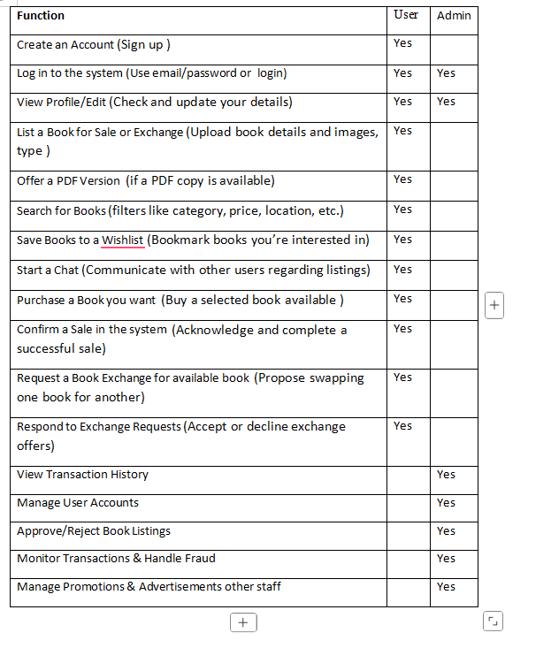
COMPARISION TABLE

Slide 14
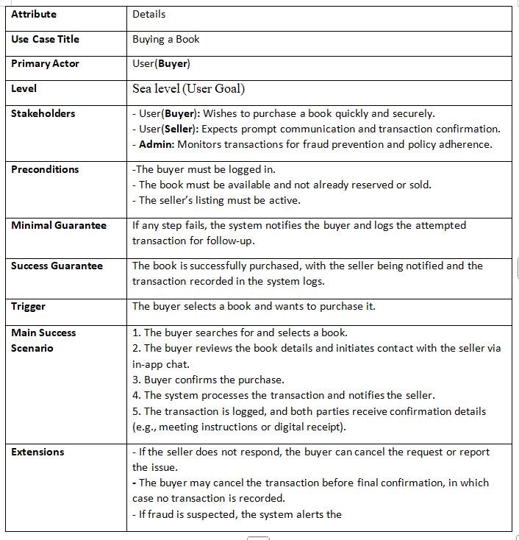
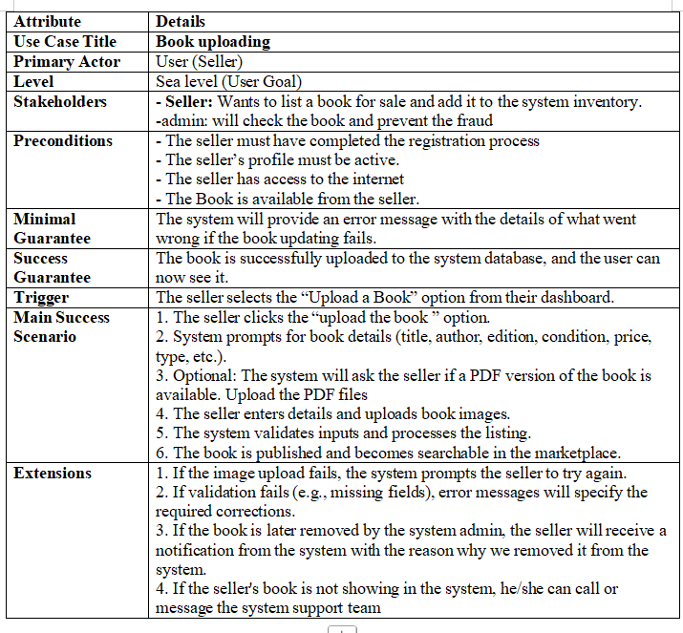
USE CASE TABLES

Slide 15
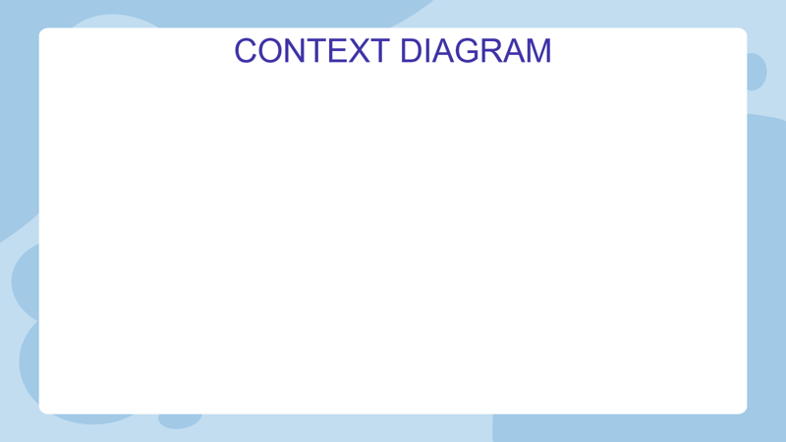
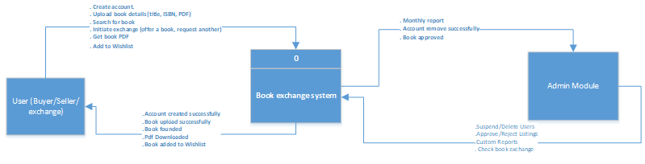

Slide 16
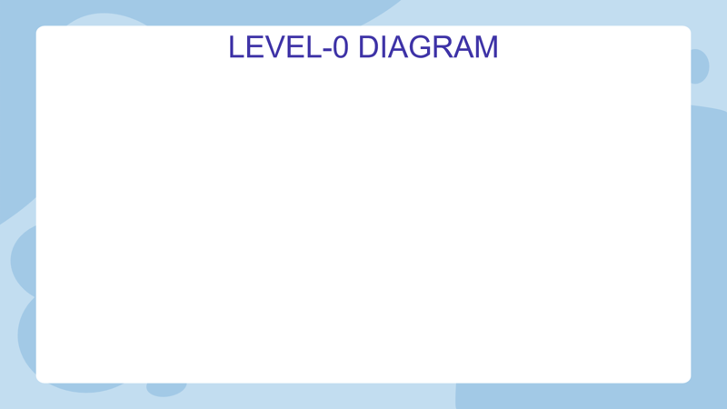
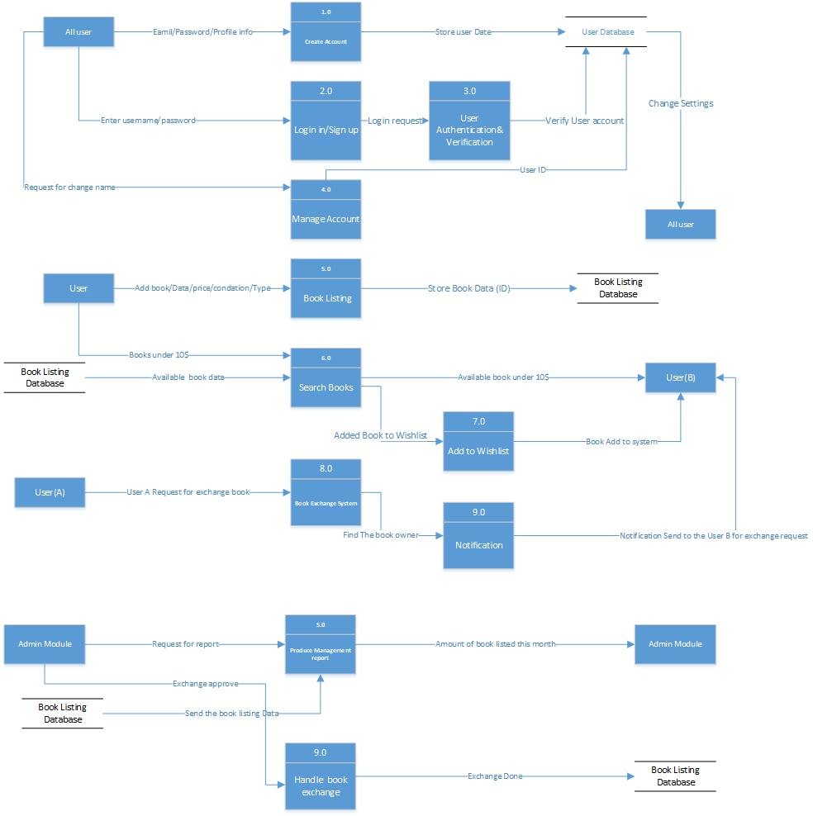

Slide 17
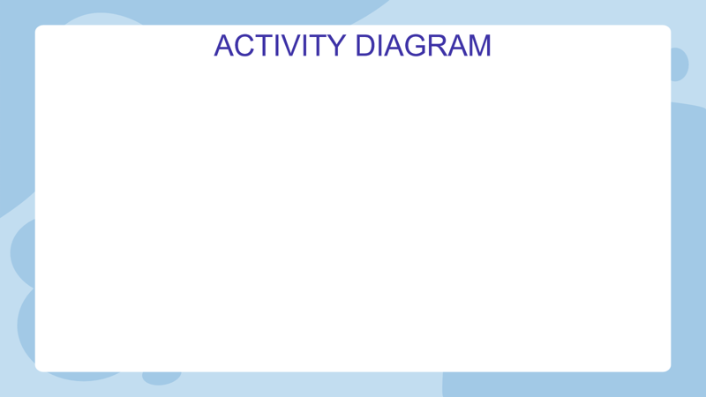
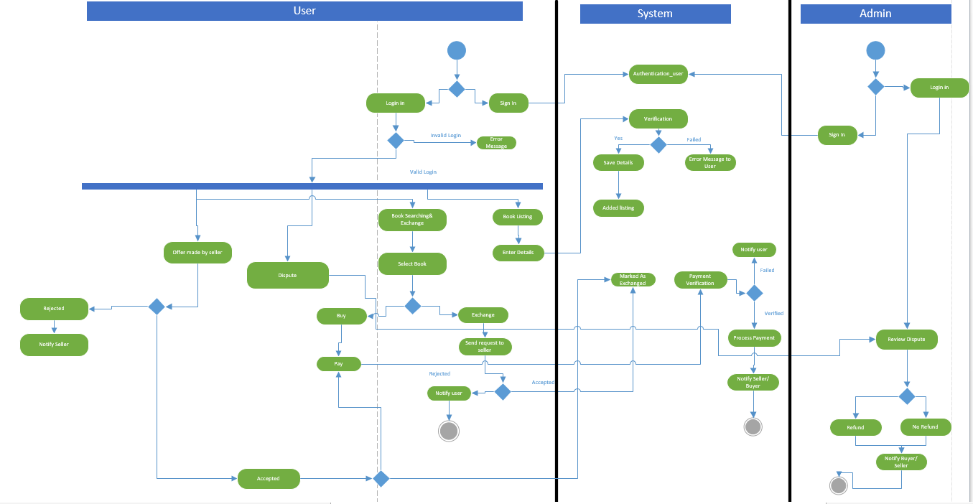

Slide 18
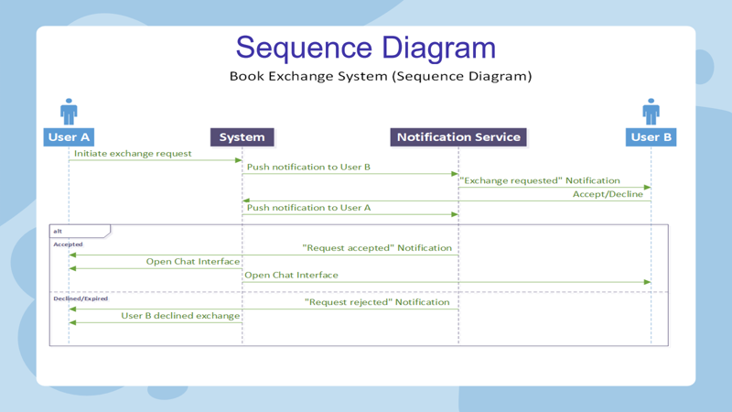

Slide 19
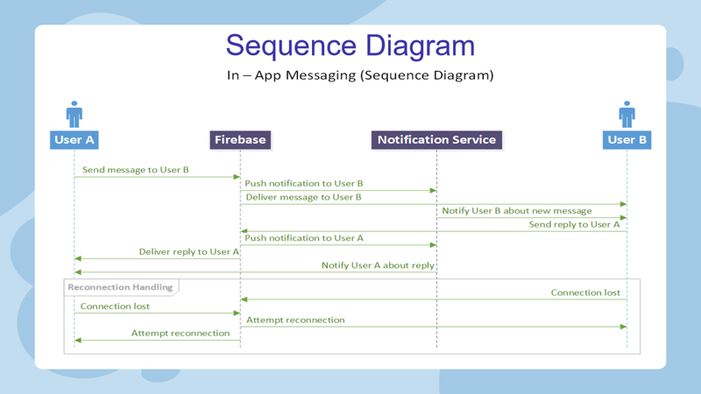

Slide 20
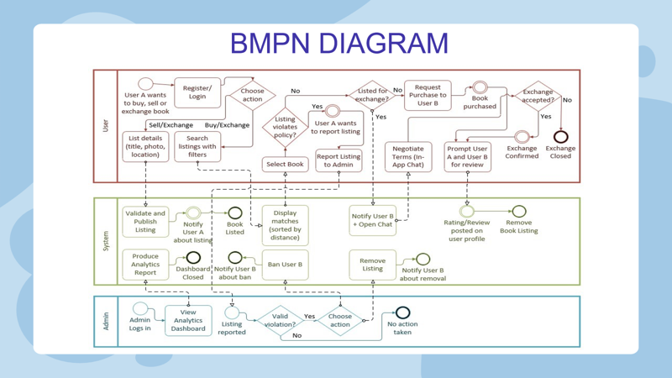

Slide 21
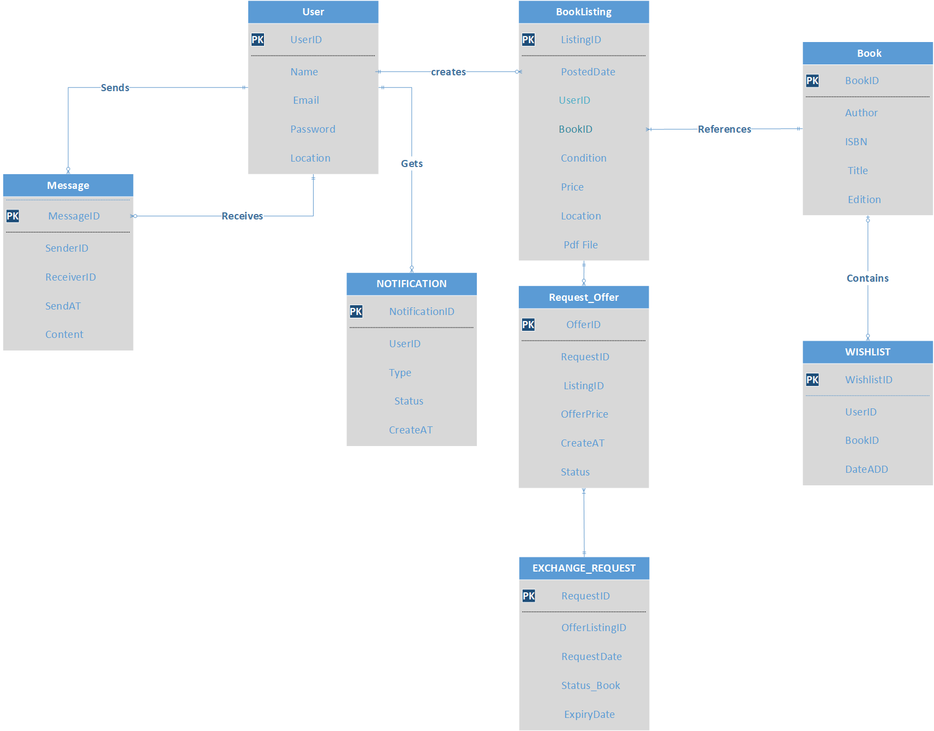
Logical database

Slide 22
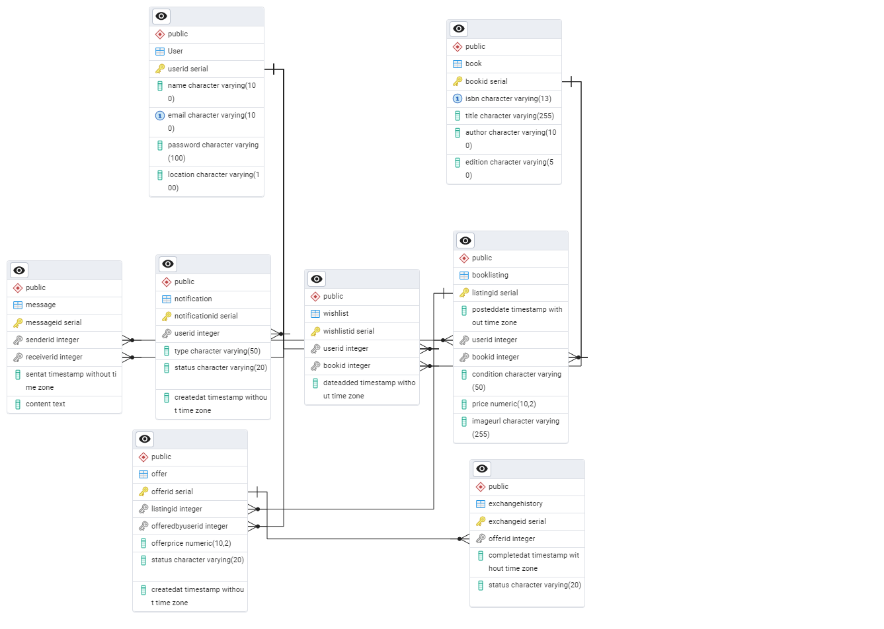
Physical database

Slide 23
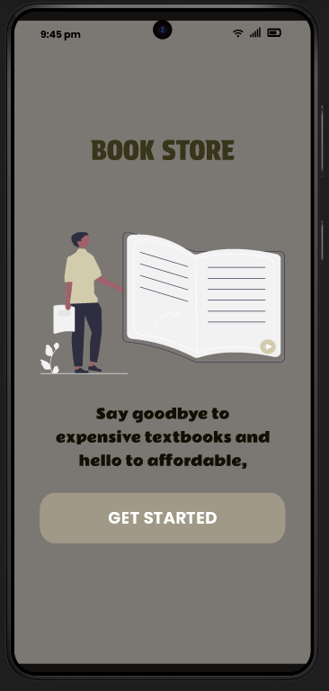
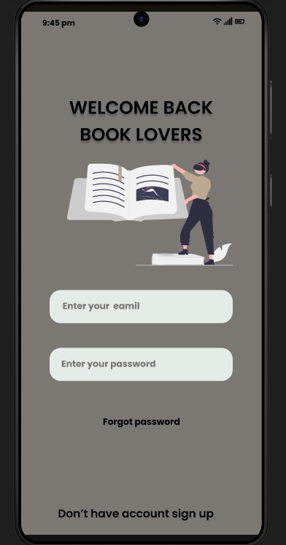
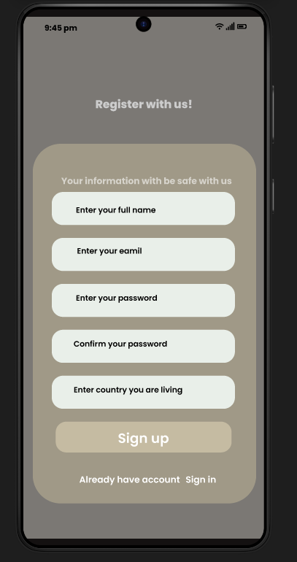
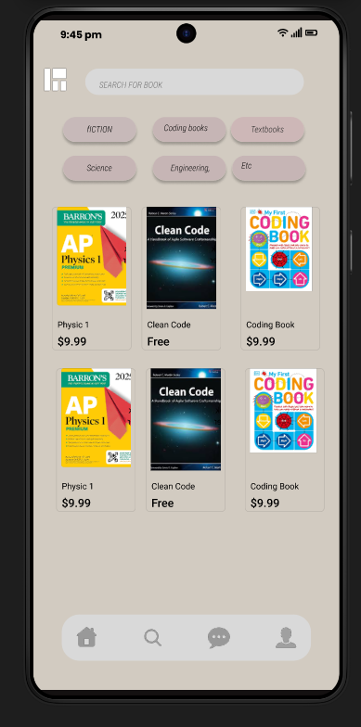
Ui/ UX design

Slide 24
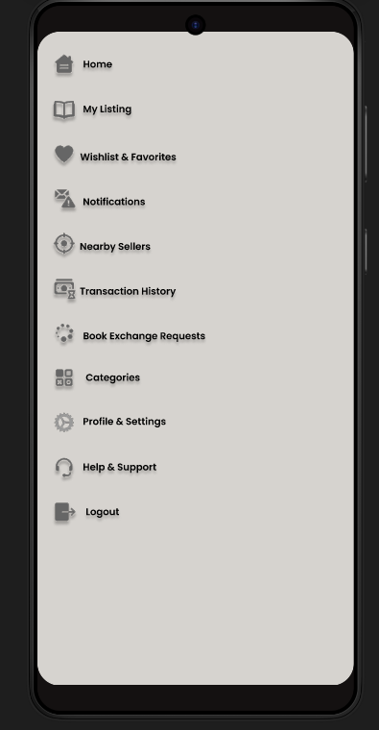
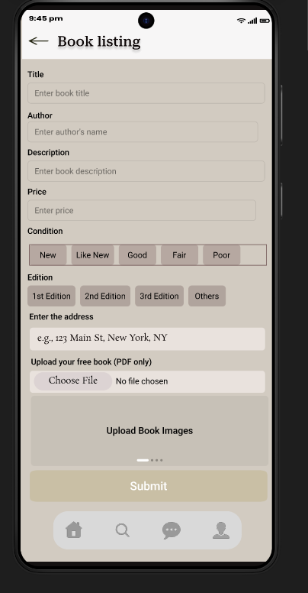
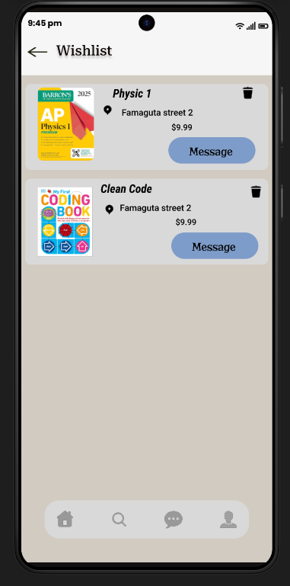
Ui/ UX design

